Slide 1
Chapter 7
Interest Groups
American Democracy Now, 7th edition
Brigid Callahan Harrison
Jean Wahl Harris
Michelle D. Deardorff
Copyright 2022 © McGraw Hill LLC. All rights reserved. No reproduction or distribution without the prior written consent of McGraw Hill LLC.

Slide 2
The Value of Interest Groups 1
Interest group: an organization that seeks to achieve goals by influencing government decision making.
Estimates indicate that about 80 percent of all Americans belong to some kind of voluntary group or association, although not every group is an interest group.

Slide 3
The Value of Interest Groups 2
In Bowling Alone, Robert Putnam found a marked decrease in the number of people who belong to interest groups and other types of organizations.
These organizations, Putnam argues, are essential sources of social capital, the relationships that improve our lives by giving us social connections with which to solve common problems.
Critics of Putnam have noted that people are engaged in other types of groups and clubs and enjoy various forms of group recreation.

Slide 4
Interest Groups and Civic Participation
Interest groups help people band together to influence government as a collective force.
Interest groups involve individuals more actively in the political process by encouraging them to vote and to communicate their views to their elected officials.
Interest groups assist in the engagement of communities by providing a forum through which people can come together and form associations.
Interest groups offer an alternative means of participation to individuals who are disenchanted with the two-party system, or with the status quo in general.

Slide 5
Pluralist Theory versus Elite Theory
Pluralist theory emphasizes how important it is for a democracy to have large numbers of diverse interest groups representing a wide variety of views.
Elite theory states that a ruling class composed of wealthy, educated individuals wields most of the power in government, the top universities, corporations, the military, and media outlets.

Slide 6
Key Functions of Interest Groups
Interest groups:
Educate the public about policy issues.
Provide average citizens with an avenue of access to activism.
Mobilize citizens and stimulate them to participate in civic and political affairs.
Perform electoral functions.
Provide information and expertise to policymakers.
Can protect the common good.
Are an integral part of the government’s system of checks and balances.

Slide 7
The Downside of Interest Groups
Interest groups do contribute to the appearance of (and sometimes the reality of) corruption in the political system.
They and their political action committees (PACs) make money a vital force in American politics.
These concerns have been exacerbated by the Supreme Court ruling in Citizens United v. FEC (2010).
Interest groups strengthen the incumbency advantage.
Elites are more likely to establish and to dominate interest groups than are common citizens.

Slide 8
Who Joins Interest Groups, and Why?
People are not all equally likely to join or form interest groups.
This reality has serious consequences for the ability of interest groups to represent everyone’s views.
Income and education tend to be the best predictors of interest group membership.

Slide 9
Patterns of Membership
Interest group participation is related to four demographic characteristics: income, social class, education, and race.
Interest groups historically have been dominated by white individuals with more income and education.
Increasing prominence of online interest groups has begun to diversify participation.

Slide 10
Traditional Interest Groups
Income and education as predictors of membership.
People with higher incomes are more likely to participate as are those with a greater education level.
They have more disposable income, greater understanding of issues, and often professional interests to care for.
Interest group participation and social class.
In general, working-class individuals are less likely to have been socialized to participate in traditional interest groups.
One important exception is labor unions.

Slide 11
Modern Equality and Rights Movements
Over the past years, several social movements have emerged in the United States.
Black Lives Matter.
Successes seen by the gay rights movement, and an increasingly active transgender rights movement.
These groups, which tend to be loosely organized, have thrived in an era in which the Internet facilitates the organization and mobilization of large numbers of like-minded people.

Slide 12
Motivations for Joining Interest Groups
Solidary incentives: the feeling of belonging, companionship, friendship, and the satisfaction derived from socializing with others.
Purposive incentives: believing in the group’s cause from an ideological or a moral standpoint.
Economic incentives: wanting to support groups that work for policies that will provide them with economic benefits.

Slide 13
How Interest Groups Succeed
Why are some interest groups better at getting what they want than others?
Political scientists agree on various factors that influence whether an interest group will succeed.
These factors include the interest group’s organizational resources, and its organizational environment.

Slide 14
Organizational Resources
Effectiveness of interest groups in influencing government policy often depends on the resources these groups use to sway policy makers.
Interest groups success relies on two key types of resources: membership and finances.

Slide 15
How Membership Affects Success
Large membership enhances an interest group’s influence because policymakers are more likely to take note of the group’s position.
Cohesion of a group also matters to participants and to policy makers.
Another significant aspect of an interest group’s membership is its intensity.
Demographics of a group’s membership also may increase its success.

Slide 16
How Financial Resources Affect Success
Money fuels the hiring of experienced and effective staff and lobbyists, as well as the undertaking of initiatives that will increase the group’s membership.
Money also funds the raising of more money.
Groups may form a PAC to contribute money to the campaigns of favored candidates, particularly incumbents who are likely to be reelected.

Slide 17
Organizational Environment
Strong, charismatic leaders can raise public awareness of the group and its activities.
Enhancing its reputation.
Making the organization attractive to new members and contributors.
Presence of opposing groups can also have an impact
When a group is the sole interest group for a particular issue, policymakers are more likely to rely on that group’s views.
If groups with opposing views are also attempting to influence policy, getting policymakers to act strongly in any one group’s favor is more difficult.

Slide 18
Types of Interest Groups
Political scientists generally categorize interest groups by what kinds of issues concern them and who benefits from the groups’ activities.
Interest group categories:
Economic.
Public and ideological.
Foreign policy.

Slide 19
Economic Interest Groups 1
Corporate and business interests typically seek policies that benefit a particular company or industry.
Business and interest groups also commonly advocate for policies using umbrella organizations: interest groups representing groups of industries or corporations.
About 11 percent of U.S. workers belong to unions.
AFL-CIO is among the nation’s most powerful, though its influence has waned as membership has decreased.
Public employees are among the most unionized workforces, with 35 percent public employee union membership.

Slide 20
Economic Interest Groups 2
Agricultural interests probably have the most disproportionate amount of influence, given the small number of farmers and farm workers in the country relative to the general population.
Nearly every professional occupation has a trade or professional group that focuses on its interests.

Slide 21
Public and Ideological Interest Groups 1
Public interest groups are concerned with a broad range of issues that affect the populace at large.
Results of the efforts of a particular public interest group’s advocacy are collective goods.
Free rider problem: someone enjoying a benefit without any effort.
Rational choice theory: Why act if you can ride free?

Slide 22
Public and Ideological Interest Groups 2
Consumer interests.
Today, consumer interest groups advocate for a wide variety of issues, including food safety, fair pricing of pharmaceuticals, commercial airline fliers’ rights, and more.
Environmental interests.
Many environmental interest groups came about as a result of a broader environmental movement in the 1970s.
Religious interests.
Religious interests are among the most influential interest groups in U.S. politics.

Slide 23
Foreign Policy Interests
Foreign governments often will benefit from the efforts of an interest group made up of U.S. citizens of the foreign nation’s heritage.
Examples: American Israel Public Affairs Committee (AIPAC); Cuban American National Foundation.
China has spent millions of dollars trying to influence trade and other U.S. policies to its advantage.
International corporations based abroad press for U.S. policies that are beneficial to them.
Foreign entities cannot contribute money to political campaigns but they can lobby the U.S. government.

Slide 24
Interest Group Strategies
Interest groups use two kinds of strategies to advance their causes.
Direct strategies involve actual contact between representatives of the interest group and policymakers.
Indirect strategies use intermediaries to advocate for a cause or generally to attempt to persuade the public, including policymakers, to embrace the group’s position.

Slide 25
Direct Strategies to Advance Interests
Groups often opt for direct strategies when they seek to influence a specific piece of legislation.
Direct strategies include:
Lobbying.
Litigation.
Providing information or expert testimony.

Slide 26
Lobbying, Issue Networks, and Iron Triangles 1
Lobby: to communicate directly with policymakers on an interest group’s behalf.
Groups hire knowledgeable insiders as lobbyists.
Former government officials, including cabinet officials, members of Congress, and congressional staffers.
Frequently, this practice creates an issue network, a fluid web of connections among those concerned about a policy and those who create and administer the policy.

Slide 27
Lobbying, Issue Networks, and Iron Triangles 2
Interest group’s efficacy often depends on it having close relationships with the policymakers involved in decisions related to the group’s causes.
Iron triangle: the interaction of mutual interests among members of Congress, executive departments and agencies, and organized interests during policy making.

Slide 28
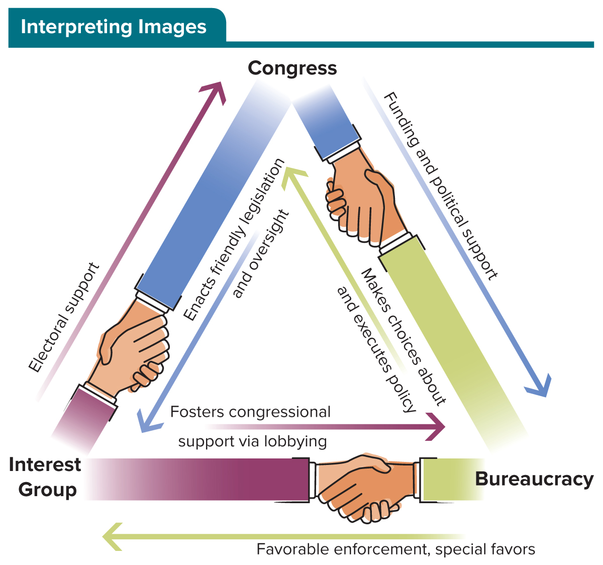
Figure 7.1 Iron Triangle
Access the text alternative for slide images.

Slide 29
Litigation by Interest Groups
Sometimes interest groups challenge a policy in the courts.
Citizens United v. Federal Election Commission (2010).
There are several benefits to using litigation.
Ensuring new laws are constitutional.
Shaping future policy.
Encouraging enforcement by executive agencies.

Slide 30
Providing Information and Expert Testimony
Interest groups are one of the chief sources of information for policymakers.
Interest groups have the resources to investigate the impact of policies.
They have access to data, technological know-how, and a bevy of experts with extensive knowledge of the issues.
Sometimes they will use celebrities as “experts” because it will attract greater attention.

Slide 31
Indirect Strategies
Interest groups deploy citizens as grassroots lobbyists and they engage in electioneering in an attempt to persuade the public that their position is right.
Indirect tactics are likely to be ongoing rather than targeted at a specific piece of legislation.

Slide 32
Public Outreach
Interest groups work hard to make the public, government officials, and others aware of issues of concern.
Educating the public through ad campaigns.
Encouraging civic discourse.
Using climate control—using public outreach to build a favorable public opinion of the organization or company.
Other groups, especially those without a great deal of access to policymakers, may engage in protests and civil disobedience to be heard.

Slide 33
Electioneering
Electioneering: working to influence the election of candidates who support an interest group’s issues.
Electioneering tactics are active methods of civic participation.
Endorsements of candidates or positions.
Get-out-the-vote drives.
Campaign contributions.
Favor incumbents over challengers.

Slide 34
Interest Groups, Politics, and Money: The Influence of Political Action Committees
Funding campaigns establish the interest group as a formal supporter of one or more candidates.
Campaign contributions are a door opener for an interest.
Access to policymakers is crucial.
Labor groups tend to support Democrats, whereas many business and corporate PACs favor Republicans.

Slide 35
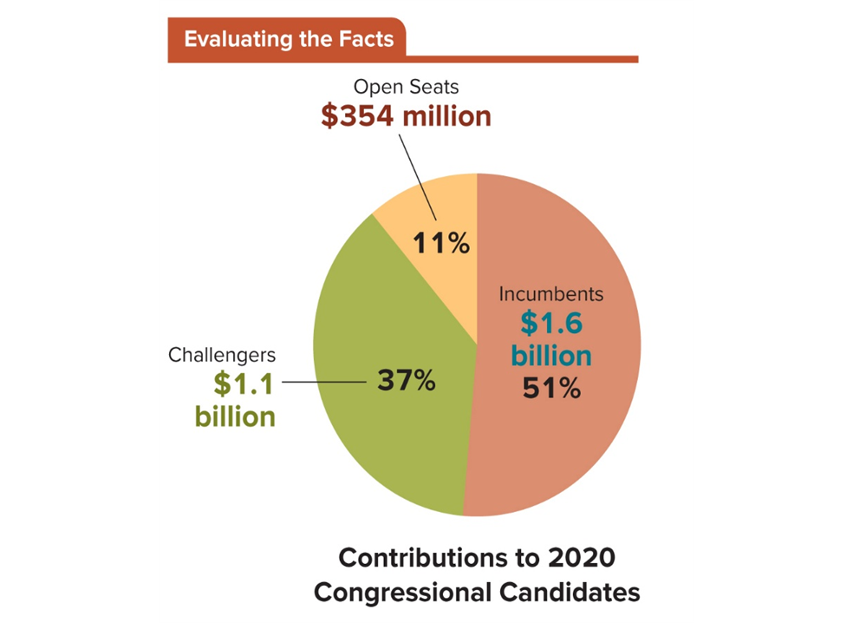
Figure 7.2 Incumbents and Challengers
In 2020, 438 incumbent members of the House and Senate ran against 1,341 challengers, while 529 candidates ran for open seats. Incumbents received more than half of the funds donated, though by a lower margin than in many years.
Access the text alternative for slide images.
SOURCE: Center for Responsive Politics, https://www.opensecrets.org/elections-overview/incumbent-advantage

Slide 36
Table 7.1 Top PAC Contributors to Candidates, 2019–2020
PAC NAME | TOTAL AMOUNT | PERCENT TO DEMOCRATS | PERCENT TO REPUBLICANS
Operating Engineers Union | $1,989,000 | 79% | 21%
Credit Union National Association | 1,891,000 | 54 | 46
Honeywell International | 1,886,000 | 55 | 45
National Beer Wholesalers Association | 1,859,500 | 52 | 48
Sheet Metal, Air, Rail & Transportation Union | 1,826,250 | 91 | 9
Raytheon Technologies | 1,826,000 | 44 | 56
American Crystal Sugar | 1,738,500 | 52 | 48
Comcast Corp. | 1,736,700 | 46 | 54
National Air Traffic Controllers Association | 1,724,600 | 67 | 33
National Association of Realtor | 1,715,195 | 53 | 47
Table divided into 4 columns summarizes top PAC contributors to candidates, 2019 to 2020. The column headers are marked from left to right as: PAC name, total amount, percent to Democrats, and percent to Republicans.
SOURCE: The Center for Responsive Politics, OpenSecrets.org

Slide 37
Review 1
Then—Individuals joined voluntary organizations to achieve goals of value to their members and to influence the direction of society and government.
Now—Interest groups and social movements continue to be important vehicles that citizens use to persuade government to act in their interest, and technology has now transformed the tactics these groups use.

Slide 38
Review 2
Next:
Will digital fund-raising, organizing, and web-based activism strengthen the clout and efficacy of interest groups?
Will young people continue to form and participate in groups to convey their opinions and priorities?
Will digital group activism have unintended negative consequences?

Slide 39
End of Main Content
Copyright 2022 © McGraw Hill LLC. All rights reserved. No reproduction or distribution without the prior written consent of McGraw Hill LLC.

Slide 40
Accessibility Content: Text Alternatives for Images

Slide 41
Figure 7.1 Iron Triangle - Text Alternative
Return to parent-slide containing images.
The interest group provides electoral support to members of Congress; fosters congressional support by lobbying the bureaucracy; and benefits from friendly legislation and oversight from Congress, and favorable enforcement and favors from the bureaucracy.
Members of Congress provide legislation and oversight that is favored by the interest group; provides funding and political support to the bureaucracy; and benefits from electoral support from the interest group and cooperative policy choices from the bureaucracy.
The bureaucracy provides favorable enforcement and favors to the interest group and provides policy choices favorable to members of Congress; and in turn benefits from funding and political support from Congress.
Return to parent-slide containing images.

Slide 42
Figure 7.2 Incumbents and Challengers - Text Alternative
Return to parent-slide containing images.
Contributions to 2018 congressional candidates by political action committees: the pie chart shows that $986 million, or 56%, went to incumbents, $338 million, or 25%, two open seats, and $442 million, or 19% t96o challenges.
Return to parent-slide containing images.

